Slide 1


“Jai Sri Gurudev” S J C INSTITUTE OF TECHNOLOGY DEPARTMENT OF INFORMATION SCIENCE AND ENGINEERING
The Project Phase 2 Review 2
On
“REAL-TIME ATTENTION SPAN TRACKING
IN ONLINE EDUCATION”
PRESENTED BY
ADARSH K R 1111111 1111 11111111111SJ19IS002
RAKSHITHA H G 1SJ19IS128
G YOGA SAI GANESH 1SJ19IS036
GOVARDHAN J A 1SJ19IS037
Under the guidance of
Prof. Ambika L G
Dept of ISE , SJCIT

Slide 2
Contents
REAL-TIME ATTENTION SPAN TRACKING IN ONLINE EDUCATION
IMPLEMENTATION
TESTING
RESULTS
CONCLUSION

Slide 3
Implementation
REAL-TIME ATTENTION SPAN TRACKING IN ONLINE EDUCATION
MODULES : We have implemented this project using following modules.
Facial Landmark Detection
Blink Rate Detection
Eye-gaze Tracking
Emotion Classification
Overall score Calculation

Slide 4
Modules Description:
REAL-TIME ATTENTION SPAN TRACKING IN ONLINE EDUCATION
3) Eye-gaze Tracking
. The eye-gaze of a student is tracked to determine where he is looking at and is often closely associated with the , ,. M.distraction level of the student. we analyze the extracted eye region coordinates for rectangular features to identify ….eye regions containing the pupil.
. We collected 150 images with two different classes: looking straight and looking away. Our model was able to ....classify the eye gaze correctly for 113 images with an accuracy of 75.33%.
Pseudo code:
Eye Gaze Tracking
Input: Eye Co-ordinates
Output: eye moment score
Step 1: Capture student face
Step 2: Read eye coordinates
Step 3: Detect eye pupil.
Step 4: Measure eye pupil movements.
Step 5: Return eye pupil movement score.

Slide 5
Modules Description:
REAL-TIME ATTENTION SPAN TRACKING IN ONLINE EDUCATION
4) Emotion Classification
The emotion of the person attending the online class plays a major role in his attention level. This study uses facial features such as eyes, nose, and mouth, extracted using Haarcascade classifier and facial landmark detector.
Mini Exception algorithm is used to classify the emotion of the students into seven different classes - angry, disgust, fear, happy, sad, surprise, and neutral.
The model was validated using the JAFFE dataset which contains 213 images and 7 emotions posed by 10 different Japanese women. The training set consisted of 42 and 7 classes of emotion. The test set consisted of 70 images. We obtained an average accuracy of 82.55% on our test set.
Pseudo code:
Emotion detection
Input: face image
Output: Emotion score
Step 1: Capture student face
Step 2: Convert to gray
Step 3: Extract the face features.
Step 4: Apply Miniexception model
Step 5: Detect the emotion
Step 6: Return emotion score.

Slide 6
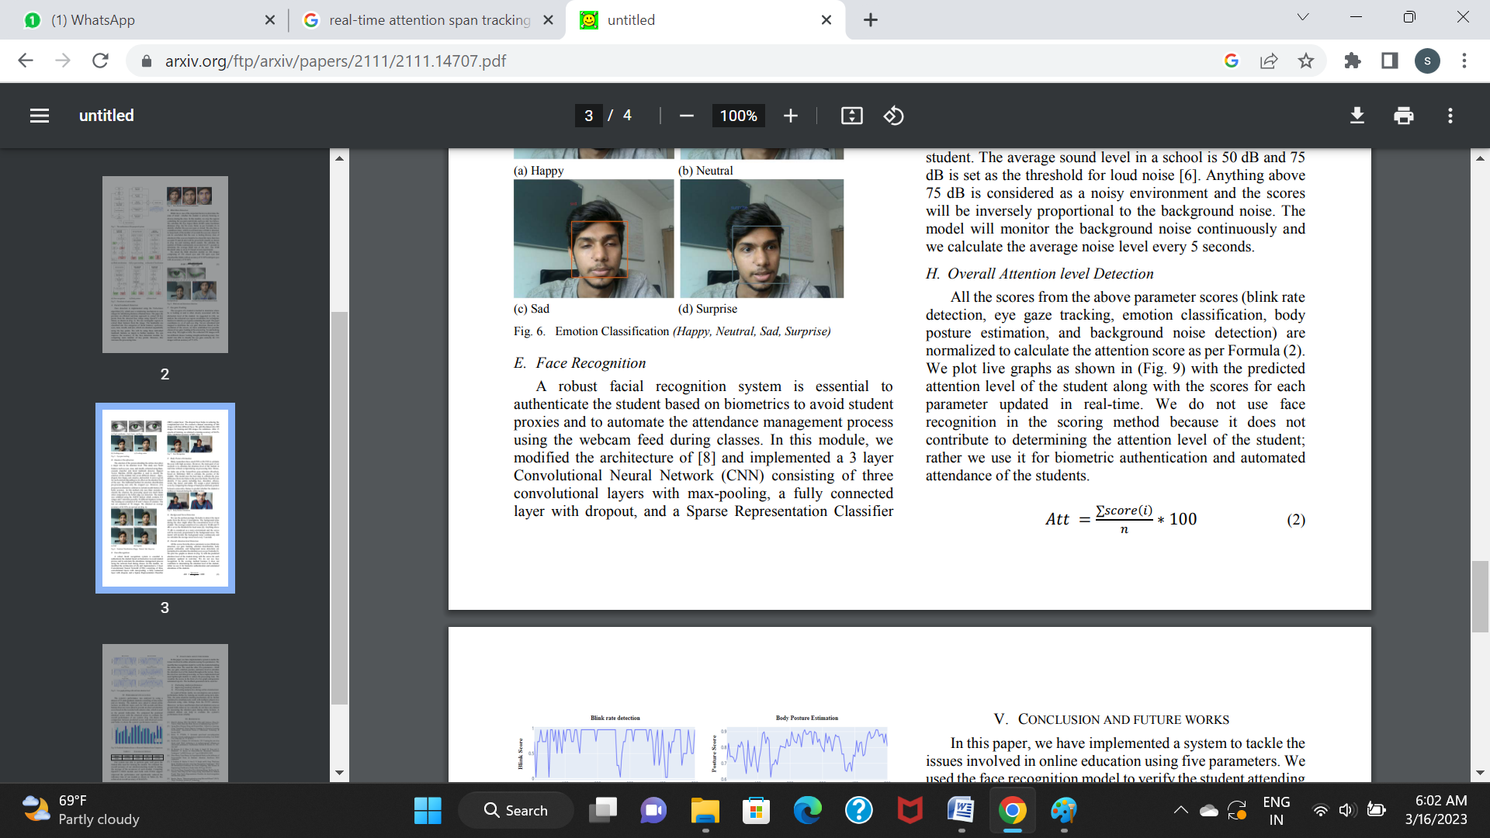
Modules Description:
REAL-TIME ATTENTION SPAN TRACKING IN ONLINE EDUCATION
5) Overall Attention level Detection
All the scores from the above parameter scores (blink rate detection, eye gaze tracking, emotion classification, body posture estimation, and background noise detection) are normalized to calculate the attention score as per Formula (2).
With the predicted attention level of the student along with the scores for each parameter updated in real-time.
Pseudo code:
Overall Attention score
Input: All the scores from previous modules
Output: Attention score
Step 1: Read all score
Step 2: Calculate average of it
Step 3: Return attention score.

Slide 7
Testing
REAL-TIME ATTENTION SPAN TRACKING IN ONLINE EDUCATION
Test Cases:-
Test Case# | UTC01
Test Name | User input format
Test Description | To test user input as face
Input | User’s face
Expected Output | It should read capture and display on screen
Actual Output | Captured and display on screen
Test Result | Success
Test Case# | UTC02
Test Name | User input format
Test Description | To test user input as face
Input | null
Expected Output | Idle state
Actual Output | Idle state
Test Result | Success
2022-23
Table no.1 : Test cases
Dept of ISE, SJCIT
6

Slide 8
Test cases(Cont..)
REAL-TIME ATTENTION SPAN TRACKING IN ONLINE EDUCATION
Test Case# | UTC03
Test Name | Attention tracking
Test Description | To test weather it is detecting drowsiness and emotion or not?
Input | Face
Expected Output | It Should predict attention score based on the training
Actual Output | Predicted Attention closer to training algorithm and display result
Test Result | Success
Table no.2 : Test cases

Slide 9
Test Cases (Cont..)
REAL-TIME ATTENTION SPAN TRACKING IN ONLINE EDUCATION
Test Case# | UTC04
Test Name | Test case for importing valid python libraries
Test Description | To test whether an algorithm to implement congestion nodes works without sklearn and scikit-learn, keras, tensorflow models
Input | Import all valid libraries sklearn, keras, tensorflow models libraries
Expected Output | An error should be thrown specifying “error importing libraries sklearn, keras, tensorflow models”
Actual Output | An error is thrown
Test Result | Success
Table no.3 : Test cases
Dept of ISE, SJCIT

Slide 10
Results
REAL-TIME ATTENTION SPAN TRACKING IN ONLINE EDUCATION
Real-time attention span tracking in online education refers to the process of using technology to measure the amount of time that students are actively engaged with the learning materials during online classes.
Real-time attention span tracking in online education can provide valuable insights into student engagement and help educators make adjustments to their teaching strategies.
However, it is important to note that attention span is not the only measure of learning, and other factors such as motivation, self-regulation, and learning preferences also play an important role in student success.

Slide 11
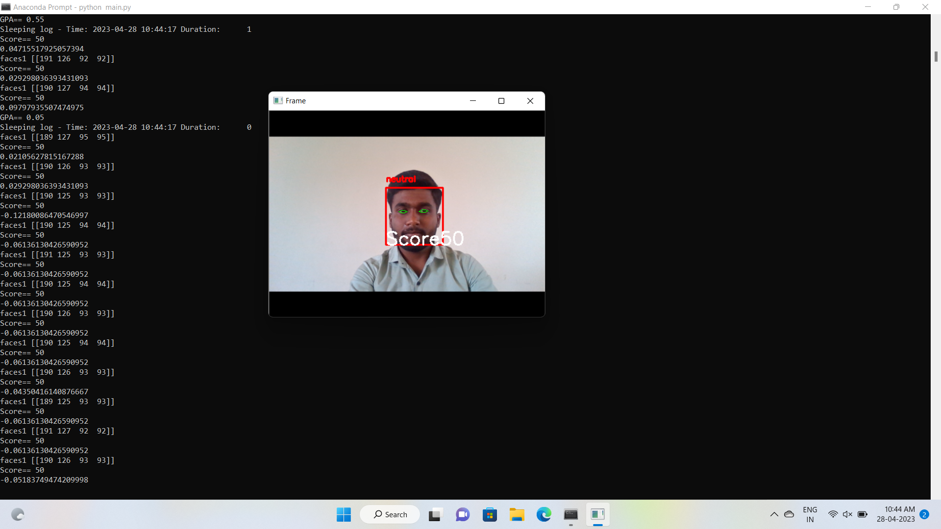
Results (Cont..)
REAL-TIME ATTENTION SPAN TRACKING IN ONLINE EDUCATION
Fig no 1 : Output when student is in neutral mode

Slide 12
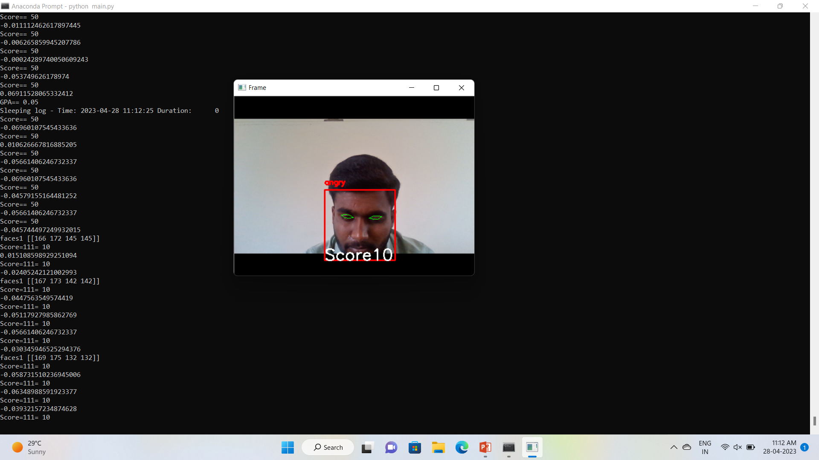
Results(Cont..)
REAL-TIME ATTENTION SPAN TRACKING IN ONLINE EDUCATION
Fig no 2 : Output when student is in angry mode

Slide 13
Conclusion
REAL-TIME ATTENTION SPAN TRACKING IN ONLINE EDUCATION
we have implemented a system to tackle the issues involved in online education using five parameters.
We used the face recognition model to verify the student attending the online class. We used the other five parameters - blink rate, eye gaze, emotion, posture, and noise level to calculate the attention level of the student throughout the lecture.
Since this involves real-time processing, we have implemented and used lightweight models to reduce the processing time.
We visualize the scores in the form of generate automated reports. The feedback generated can be used for: 1) Evaluating student performance 2) Improving teaching standards 3) Preventing malpractice during online examinations.
Also, the same attention tracking mechanism can be further optimized to simultaneously work with multiple subjects in a classroom using video footage from the CCTV cameras.
Moreover, we have used human observed attention scores as ground truth-values as we currently do not have any dataset for measuring the attention span during online lectures. A standard dataset can help to evaluate the system’s performance more reliably.
Dept of ISE, SJCIT

Slide 14
aaa
aaa
Thank you

